Slide 1
Testing Terraform Sentinel Policies Using Mocks
Roger Berlind
Sr. Solutions Engineer, HashiCorp
Email: roger@hashicorp.com
Slack: Roger Berlind @ hashiconf.slack.com
Notes:
Who I am.
I work with most of our products but am a specialist in Terraform and Sentinel.
In fact, I've written many of the sample policies in HashiCorp's terraform-guides GitHub repository
and I wrote a comprehensive guide on the writing and testing of Terraform Sentinel policies.

Slide 2
Objective
The primary objective of this session is to show how Terraform Sentinel policies can easily be tested with the Sentinel Simulator using mocks generated from Terraform plans.
Notes:
The primary objective of this session is to ...
I'll talk more about mocks later; the main thing to know for now is that they simulate the data that a plan would give to Sentinel policy checks in TFC runs.
Note that Sentinel can only be used with Terraform Cloud and its on-premise implementation, Terraform Enterprise

Slide 3
Why?
Why should you use the Simulator and mocks?
Speed up the creation of new Sentinel policies since you don't have to wait for plans to run.
Enable testing of various combinations of possible attributes with a single command.
Notes:
Why should you use the Simulator and mocks?
It's faster. Before Terraform Cloud could generate mocks, I tested all my policies by triggering runs against workspaces.
This meant I had to wait for a plan to run for each test. The plan usually took longer than the policy check.
Also, by using the Simulator with mocks, you can test multiple combinations of possible attributes.
That also speeds up your testing.
Before we get to the simulator and mocks, however, I would first like to set the stage so you understand what Sentinel is and how it is used in Terraform

Slide 4
Agenda
What is Sentinel?
How is Sentinel Used in Terraform?
Sentinel Imports in Terraform
Sentinel Mocks in Terraform
Writing and Testing Terraform Sentinel Policies
Demo of Testing Sentinel Policies with Mocks
Notes:
I'll start out by talking about Sentinel, then talk about how it is used in Terraform.
This will include Sentinel imports and mocks.
I'll then discuss an 8-step methodology for writing and testing Terraform Sentinel policies that uses mocks generated from Terraform plans and the Sentinel Simulator.
I'll then give a demo of using mocks with the simulator.

Slide 5
What is Sentinel and How is It Used in Terraform?
Notes:
Now let's talk about Sentinel and how it is used in Terraform

Slide 6
What is Sentinel?
HashiCorp's Sentinel is a framework for implementing governance policies as code in the same way that Terraform implements infrastructure as code.
It includes its own language and is embedded in HashiCorp's enterprise products.
Using Sentinel ensures that your governance policies are actually being checked rather than just being listed in a spreadsheet.
It supports fine-grained policies that use conditional logic.
It includes a simulator that allows you to test policies.
Notes:
Sentinel is a framework for governance as code just like Terraform implements infrastructure as code.

Slide 7
How is Sentinel Used in Terraform?
Sentinel Policies are checked between the standard Plan and Apply steps of runs in Terraform Cloud (TFC) and Terraform Enterprise (TFE).
Violations prevent runs from being applied unless a user with sufficient authority overrides them.
Sentinel policies can evaluate the attributes of existing and new resources based on information associated with the current run:
the plan, the configuration, the current state, and other run data
This ensures that resources comply with all policies before they are provisioned.
Notes:
Sentinel policies are checked between the plan and apply steps of runs in in TFC and TFE.

Slide 8

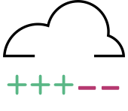

VCS
Terraform
Cloud
Workspace
plan
Sentinel
Policy Checks
apply
Infrastructure
Notes:
We see here that Sentinel policy checks occur between the plan and apply steps of a Terraform Cloud run.
Terraform code is typically loaded into a Terraform Cloud workspace from a VCS repository
A plan is run against the code.
Then Sentinel policy checks are run against the data provided by the plan and workspace.
If the checks all pass or failures are overridden, an apply can be done to provision infrastructure.

Slide 9
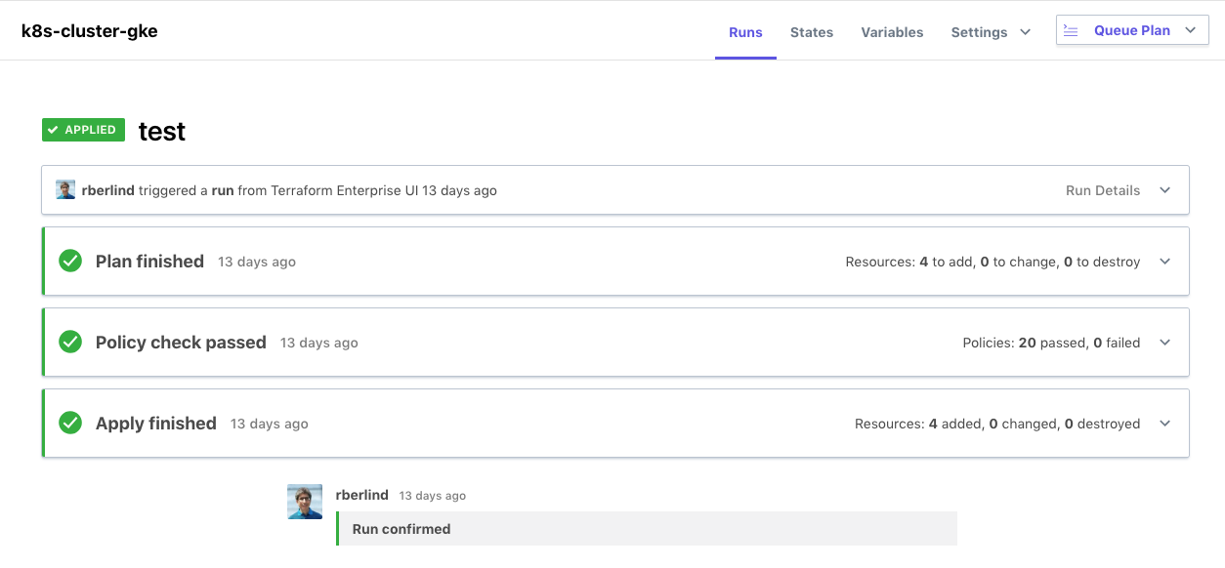
Notes:
This screenshot of a run in the TFC UI also shows that Sentinel policy checks occur between the plan and apply steps of a Terraform Cloud run.
If cost estimates are enabled for the workspace, the cost estimate will be done between the plan and the policy checks.
This allows Sentinel policies to check the cost estimate data.

Slide 10
Sentinel Imports in Terraform
Sentinel includes several standard imports.
The tfplan import gives access to the Terraform plan used by the current run.
The tfconfig import gives access to the Terraform configuration (the Terraform code) used by the current run.
The tfstate import gives access to the current state of the workspace of the current run.
The tfrun import gives access to workspace and cost estimate data of the current run.
The tfplan import is the most frequently used import since it lets users restrict specific attributes of new resources.
Notes:
Sentinel includes several standard imports available across all HashiCorp solutions that use Sentinel.
These include imports for working with strings and JSON documents
Terraform adds some additional imports to expand the capabilities of Sentinel.
tfplan is most frequently used.

Slide 11
Sentinel Mocks in Terraform
Sentinel Mocks simulate the data that is made available to Sentinel policies from Terraform Cloud plans.
There is one mock for each of the four Terraform Sentinel imports
They can be generated from recent plans using the Terraform Cloud UI and API and then copied and edited to simulate various combinations of resource attributes.
They enable testing of Terraform Sentinel policies with the Sentinel Simulator.
Using mocks with the Sentinel Simulator speeds up testing of new policies since you do not need to run plans.
Using them also makes testing multiple scenarios easier.
Notes:
Now, let's talk about Sentinel mocks in Terraform.

Slide 12
Writing and Testing Sentinel Policies for Terraform
Notes:
I would now like to outline my 8-step methodology for writing and testing Sentinel policies for Terraform.
This methodology is from my Guide for Writing and Testing Sentinel Policies for Terraform

Slide 13
Basic Methodology for Writing and Testing Policies
Create a Terraform configuration that creates resources.
Create a Terraform Cloud workspace that uses the configuration.
Run a plan against the workspace.
Generate mocks against the plan in the TFC UI.
Write a new Sentinel policy.
Create test cases and test your policy with the Simulator.
Revise your policy and test cases until the latter all pass.
Deploy your policy to a TFC organization.
Notes:
Step 4 is where we generate the mocks.
Step 6 includes the creation of test cases that use the mocks generated in step 4.
We will focus on and demo the bold-faced steps in this talk: 3, 4, 6, and 7.

Slide 14
Run a Plan and Generate Mocks
Run a plan against a TFC workspace or select a plan you ran within the past 7 days.
Expand the Plan in the TFC UI.
Click the "Download Sentinel mocks" button.
After a minute, a tar.gz file with 4 mocks will be downloaded.
Extract the mock files from the tar.gz file.
Mocks can contain sensitive data. Please handle them securely.
Notes:
The main step here is to click the "Download Sentinel mocks" button under the plan that you pick.
Please note that mocks can contain sensitive data. Please handle them securely.

Slide 15
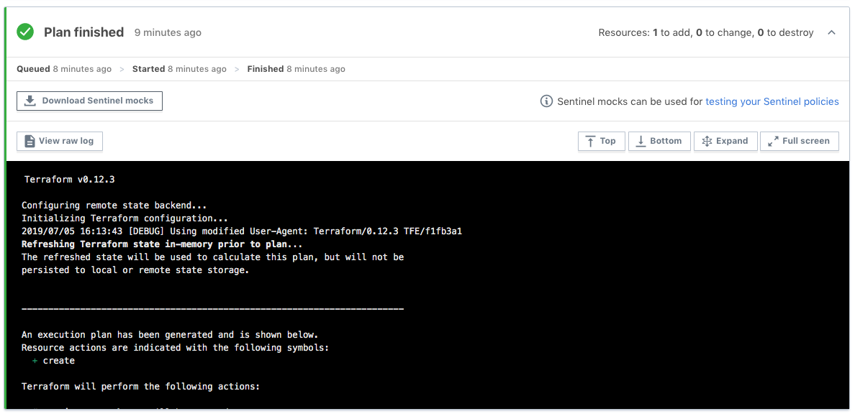
Run a Plan and Generate Mocks
Click this button
Notes:
Here we see a screenshot of a plan in the TFC UI and the button you can click to generate the mocks.

Slide 16
Write a Terraform Sentinel Policy
For our demo, we will use two Terraform Sentinel policies:
restrict-gce-machine-type.sentinel restricts the size of Google Compute Engine (GCE) instances to the types n1-standard-1, n1-standard-2 and n1-standard-4.
require-private-acl-and-kms-for-s3-buckets.sentinel requires that AWS S3 buckets use the "private" canned ACL and be encrypted by a KMS key.
This policy is useful for illustrating how to test a policy that has multiple conditions.
Notes:
Here are the Sentinel policies I'll be using in my demo.

Slide 17
Create Test Case Directories
You need to set up test cases that use your mocks.
Under the directory containing your policy, create a test directory.
Under the test directory, create a directory with the same name as your policy, but without the ".sentinel" extension.
For our restrict-gce-machine-type.sentinel policy, create the restrict-gce-machine-type directory under the test directory.
Copy the mock-tfplan.sentinel mock file that you downloaded and extracted from your workspace to this directory.
Notes:
In order to test your policies with the Sentinel Simulator, you first need to create test case directories that use your mocks.
The simulator is particular about the organization and names of directories.
We need to create a test directory under the directory containing the policies.
We need to create directories for each policy under the test directory with matching names.

Slide 18
Create a Pass Test Case
Rename the mock file to mock-tfplan-pass.sentinel.
Create a pass.json file that looks like this:
{
"mock": {
"tfplan": "mock-tfplan-pass.sentinel"
},
"test": {
"main": true
}
}
Notes:
We are creating two test cases: one that will pass and one that will fail.
Each will have its own copy of the mock file that was generated from our plan.
But we will edit those mocks to have different values of the attribute we are testing.
If you want to use the Sentinel Simulator to test against both Terraform 0.11.x and 0.12.x, do the following:
Generate two sets of mocks, one for Terraform 0.11.x when it is set to use Terraform 0.11.x and one for 0.12.x after the Terraform vesion has been set to 0.12.x.
Create mock-tfplan-pass-0.11.sentinel and mock-tfplan-fail-0.11.sentinel files from the 0.11 version of the mock-tfplan.sentinel mock.
Create mock-tfplan-pass-0.12.sentinel and mock-tfplan-fail-0.12.sentinel files from the 0.12 version of the mock-tfplan.sentinel mock.
Edit the mocks to have values so that the pass mocks will pass and so the fail mocks will fail.
Create pass-0.11.json, fail-0.11.json, pass-0.12.json, and fail-0.12.json files that reference the four mocks.

Slide 19
Create a Fail Test Case
Create a copy of the mock and call it mock-tfplan-fail.sentinel.
Create a fail.json file that looks like this:
{
"mock": {
"tfplan": "mock-tfplan-fail.sentinel"
},
"test": {
"main": false
}
}
Notes:
Note that the fail test case says that the main rule should evaluate to false.
This means that the fail test case will pass (and give green output) when the main rule returns false against mock-tfplan-fail.sentinel.
This can be confusing to new users of the Sentinel Simulator since they expect the fail test case to fail and give red output.

Slide 20
Edit the Mocks
Edit the mock-tfplan-pass.sentinel file so that the main rule will give true for the pass.json test case.
For our restrict-gce-machine-type policy, machine_type should be one of the three allowed values for both instances.
Edit the mock-tfplan-fail.sentinel file so that the main rule will give false for the fail.json test case.
For our restrict-gce-machine-type policy, machine_type should be some other value such as n1-standard-8 for at least one instance.
Notes:
Mocks can be edited to have any values, some of which will pass and others that will fail policies.

Slide 21
Test Your Policy with the Simulator
Now that you have created your test cases, you can test your policy with the Sentinel Simulator.
Navigate back to the directory containing your policy.
Test the GCE policy:
sentinel test –run=gce
sentinel test –run=gce –verbose
To test all policies, leave off the –run argument.
Notes:
We use the "sentinel test" command to test policies.
We use the –run argument to indicate which policy we want to run, using a partial name that suffices to uniquely identify the policy.
We can use the –verbose argument to see output from print statements.
If you leave off the –run argument, all policies in the current directory will be tested.

Slide 22
Demo All required artifacts are in this repository: https://github.com/rberlind/HashiConf-2019
Notes:
Now, I'll do the demo that shows what we just walked through.
All the artifacts for it are in this repository: https://github.com/rberlind/HashiConf-2019

Slide 23
Useful Links
Sentinel Docs:
https://docs.hashicorp.com/sentinel
Terraform Sentinel Docs:
https://www.terraform.io/docs/cloud/sentinel/index.html
Documentation for Mocking Terraform Sentinel Data:
https://www.terraform.io/docs/cloud/sentinel/mock.html
GitHub Repository with Sample Terraform Sentinel Policies for AWS, Azure, GCP, and VMware:
https://github.com/hashicorp/terraform-guides/tree/master/governance
Guide for Writing and Testing Sentinel Policies for Terraform:
https://www.hashicorp.com/resources/writing-and-testing-sentinel-policies-for-terraform
Notes:
Here are some useful links.

Slide 24
Testing Terraform Sentinel Policies Using Mocks
Roger Berlind
Sr. Solutions Engineer, HashiCorp
Email: roger@hashicorp.com
Slack: Roger Berlind @ hashiconf.slack.com
Notes:
Thanks for attending this session.
I hope you found it interesting and useful.
I hope you enjoy the rest of HashiConf and have a safe trip back home.
I'll hang around up here for for 10 minutes in case any of you have questions.
You can also email or Slack me.

